Slide 1

Software requirements (swr302)
Software requirements and risk management (chapter 32)

Slide 2
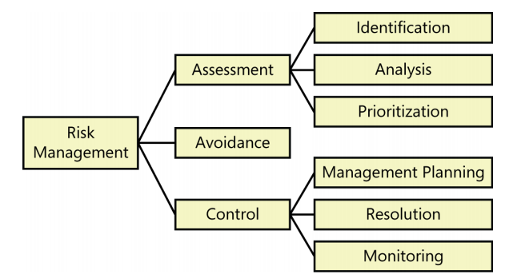
Fundamentals of software risk management
Elements of risk management

Slide 3
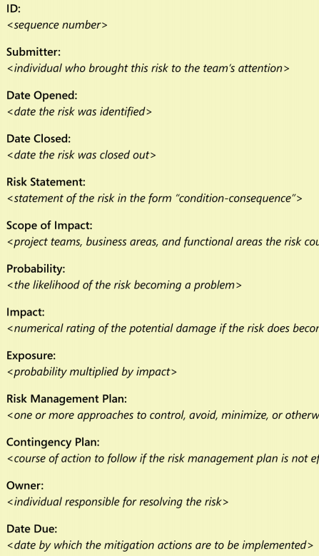
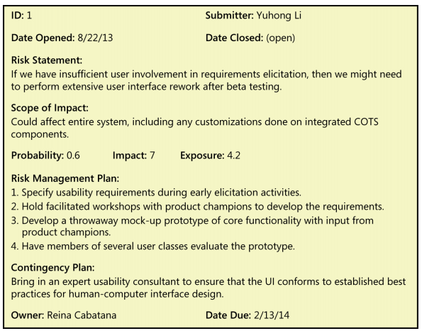
Fundamentals of software risk management
Documenting project risks
Planning for risk management

Slide 4
Requirements-related risks 1/3
Requirements elicitation
Product vision and project scope
Time spent on requirements development
Customer engagement
Completeness and correctness of requirements specifications
Requirements for innovative products
Defining nonfunctional requirements
Customer agreement on requirements
Unstated requirements
Existing product used as the requirements reference
Solutions presented as needs
Distrust between the business and the development team

Slide 5
Requirements-related risks 2/3
Requirements analysis
Requirements prioritization
Unfamiliar technologies, methods, languages, tools, or hardware
Requirements specification
Requirements understanding
Time pressure to proceed despite open issues
Ambiguous terminology
Design included in requirements
Requirements validation
Unvalidated requirements
Inspection proficiency

Slide 6
Requirements-related risks 3/3
Requirements management
Changing requirements
Requirements change process
Unimplemented requirements
Expanding project scope

Slide 7


